Slide 1
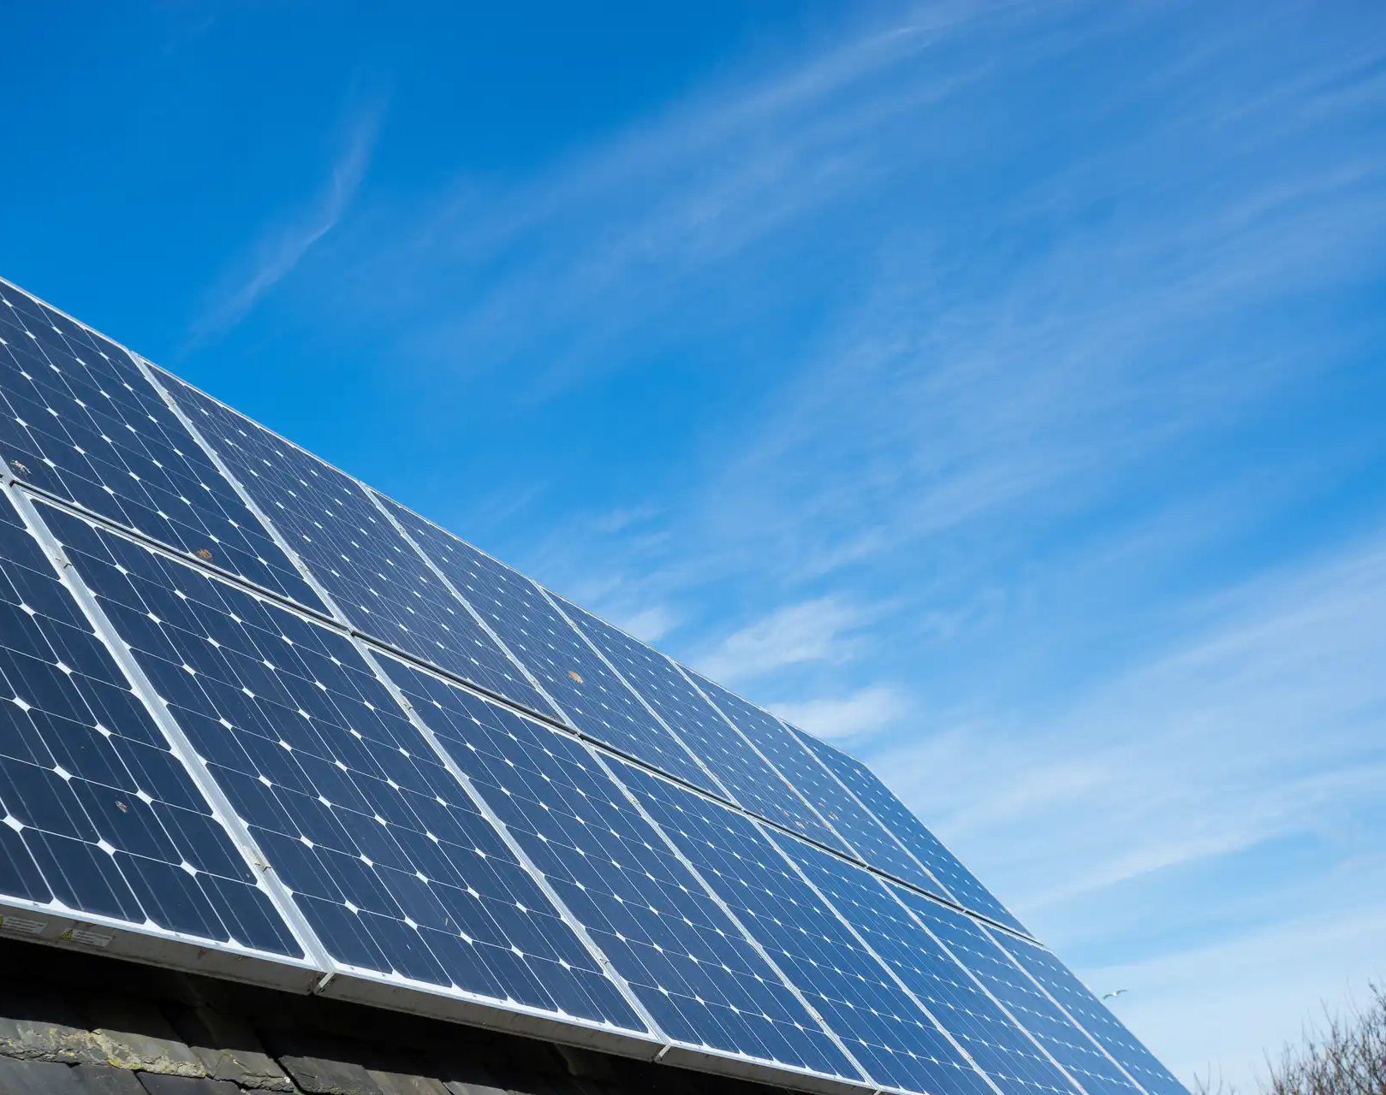



Solar analysis App
Supervisors
ZOHRABI Mohammad Reza
Candidate
Pacôme MANCEAUX
Tarun SINGH
A4 Cloud Computing & Virtualisation - 2023

Slide 2
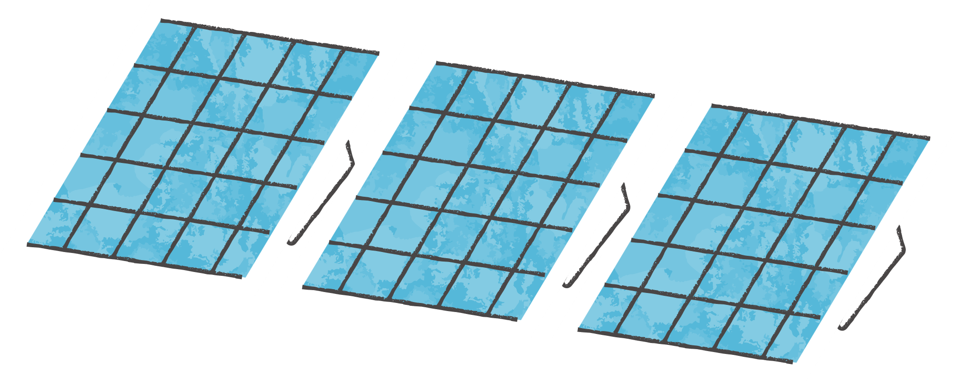
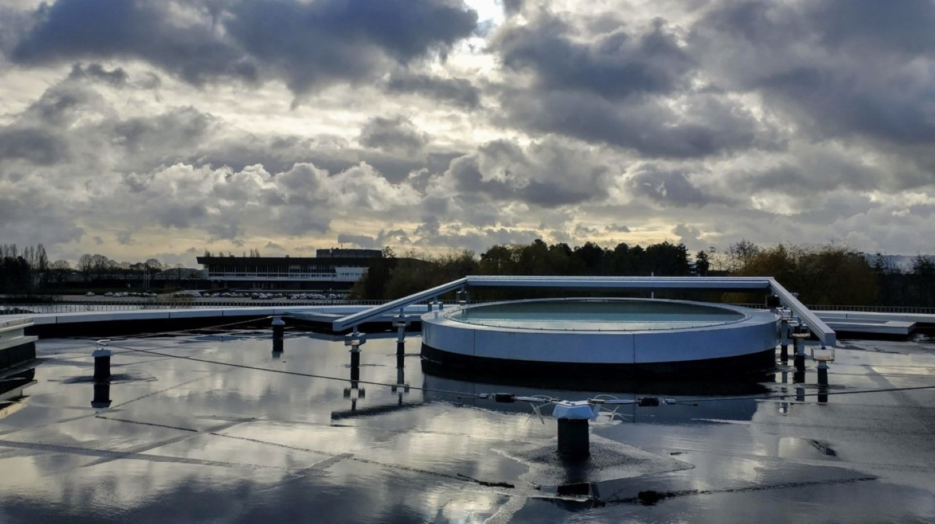
Plan
1
2
3
4
5
Introduction
Demonstration
Dockerfile and Compose
App.py
Our project Links
What is the project context ? What are the project objectives?
Here you will see the whole project outcome
Our backend and frontend file
We will see our Dockerfile and Compose file
Github and Dockerhub links
A4 Cloud Computing & Virtualisation - 2023

Slide 3


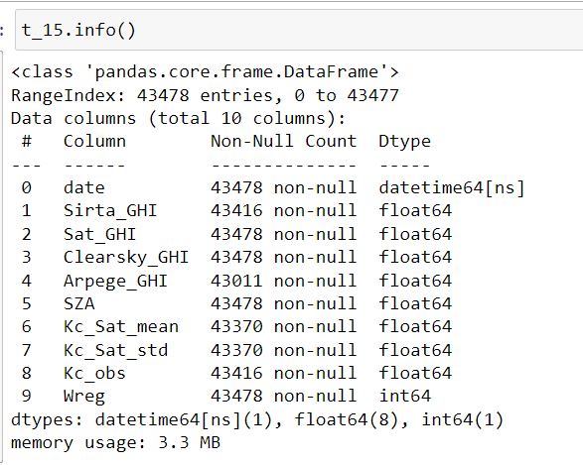
Introduction
Data is separated into 24 datasets according to the satellite forecast time horizon (every 15 min over 6h)
Data ranges from July 1, 2017 to June 30, 2020
2 containers : web & database
Retrieve solar data from a csv using a bind mount
Data visualisation : table & GHI plot graph
A4 Cloud Computing & Virtualisation - 2023

Slide 4
Plan
1
2
3
4
5
Introduction
Demonstration
Dockerfile and Compose
App.py
Our project Links
What is the project context ? What are the project objectives?
Here you will see the whole project outcome
Our backend and frontend file
We will see our Dockerfile and Compose file
Github and Dockerhub links
A4 Cloud Computing & Virtualisation - 2023

Slide 5
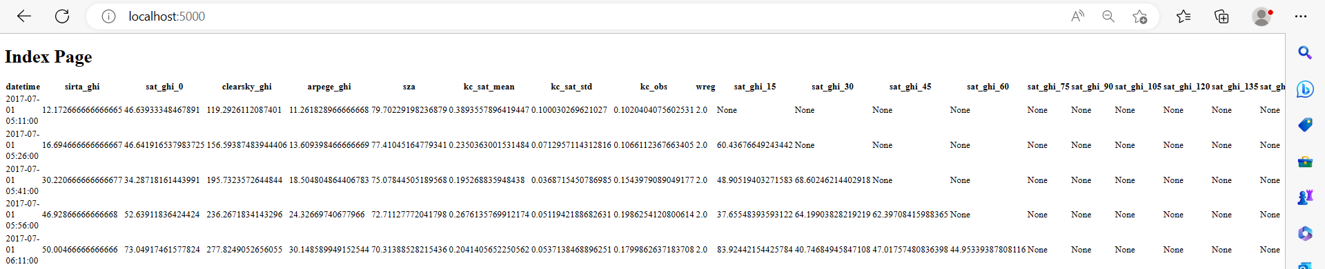
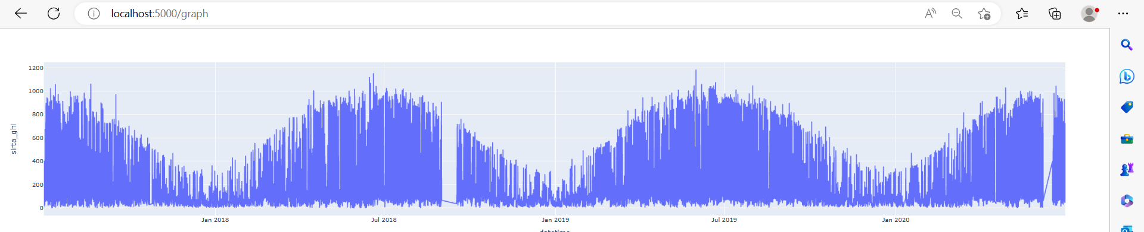
Index page
Graph page
A4 Cloud Computing & Virtualisation - 2023

Slide 6
Plan
1
2
3
4
5
Introduction
Demonstration
Dockerfile and Compose
App.py
Our project Links
What is the project context ? What are the project objectives?
Here you will see the whole project outcome
Our backend and frontend file
We will see our Dockerfile and Compose file
Github and Dockerhub links
A4 Cloud Computing & Virtualisation - 2023

Slide 7
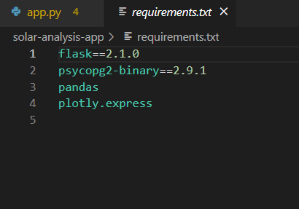


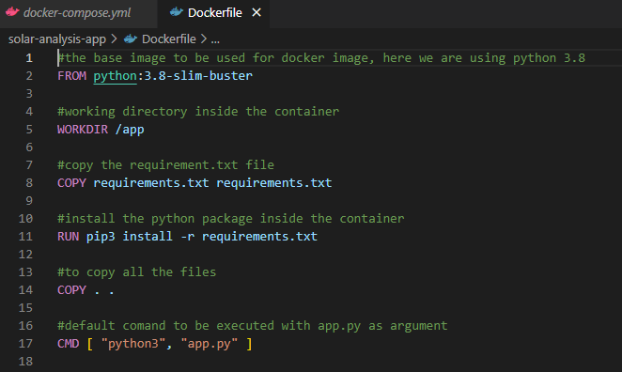
Dockerfile
requirements.txt
A4 Cloud Computing & Virtualisation - 2023

Slide 8

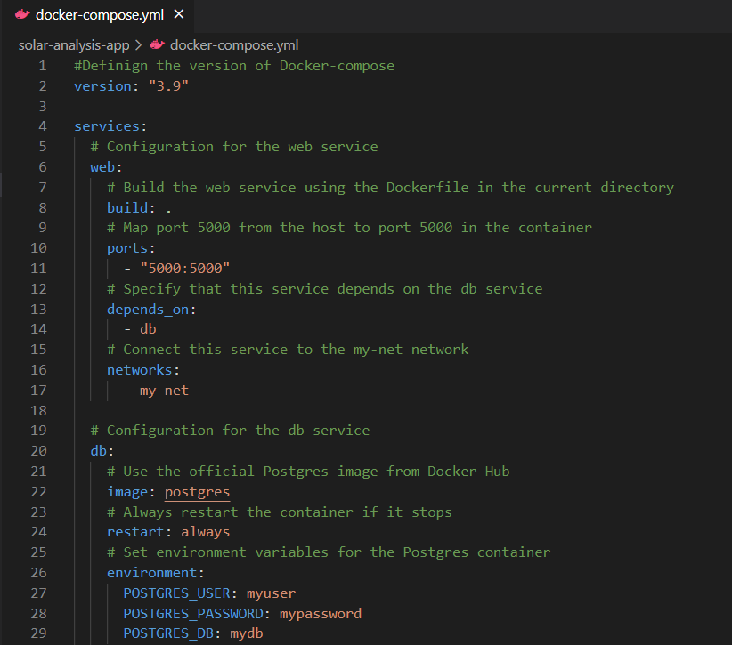
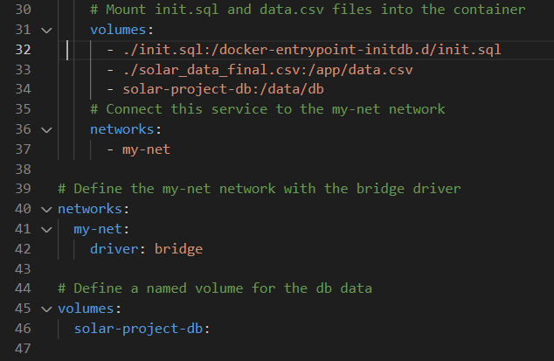

docker-compose.yml
A4 Cloud Computing & Virtualisation - 2023

Slide 9
Plan
1
2
3
4
5
Introduction
Demonstration
Dockerfile and Compose
App.py
Our project Links
What is the project context ? What are the project objectives?
Here you will see the whole project outcome
Our backend and frontend file
We will see our Dockerfile and Compose file
Github and Dockerhub links
A4 Cloud Computing & Virtualisation - 2023

Slide 10

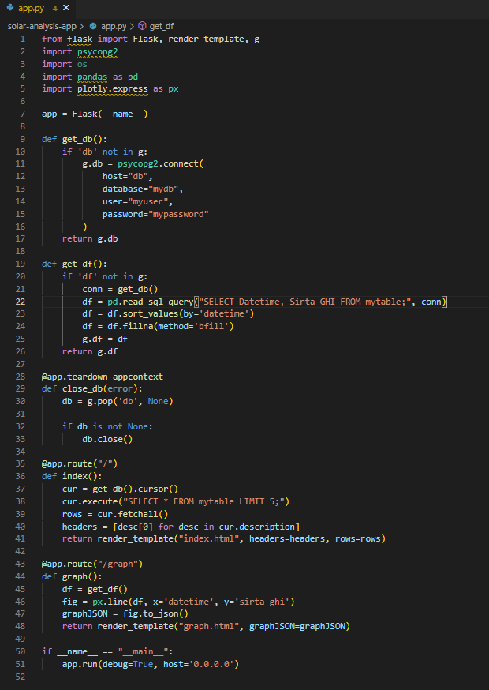

app.py
A4 Cloud Computing & Virtualisation - 2023

Slide 11
Plan
1
2
3
4
5
Introduction
Demonstration
Dockerfile and Compose
App.py
Our project Links
What is the project context ? What are the project objectives?
Here you will see the whole project outcome
Our backend and frontend file
We will see our Dockerfile and Compose file
Github and Dockerhub links
A4 Cloud Computing & Virtualisation - 2023

Slide 12

Links of the Project:
Github:
Dockerhub:
https://hub.docker.com/repository/docker/pmanceaux/solar-analysis-app/general
solar-analysis-app
docker pull pmanceaux/solar-analysis-app:latest
A4 Cloud Computing & Virtualisation - 2023

Slide 13
Thank you for your attention 😊
A4 Cloud Computing & Virtualisation - 2023

